Slide 1
Day-6
SQL Normalization/Relationship/Query
By Aksadur Rahman
aksadur@yahoo.com

Slide 2
Agenda
Understanding the RDBMS
Database Normalization
NoSQL database
Select Statement
Filtering with where clause
Joining multiple conditions
Order By
Distinct
TOP/Like

Slide 3
What is SQL Server?
SQL Server is a relational database management system (RDBMS) developed by Microsoft. It is primarily designed and developed to compete with MySQL and Oracle database. SQL Server supports ANSI SQL, which is the standard SQL (Structured Query Language) language. However, SQL Server comes with its own implementation of the SQL language, T-SQL (Transact-SQL).
T-SQL is a Microsoft propriety Language known as Transact-SQL. It provides further capabilities of declaring variable, exception
SQL Server Management Studio (SSMS) is the main interface tool for SQL Server, and it supports both 32-bit and 64-bit environments.
Version History of SQL Server
Microsoft and Sybase released version 1.0 in 1989.
However, the partnership between these two ended in the early 1990s.
Microsoft maintained ownership rights to the name SQL Server.
Since the 1990s, subsequent versions of SQL Server have been released including SQL Server 2000, 2005, 2008, 2012, 2014, 2016, 2017, and 2019.

Slide 4
Database Normalization
What is Normalization?
Normalization is a database design technique that reduces data redundancy and eliminates undesirable characteristics like Insertion, Update and Deletion Anomalies. Normalization rules divides larger tables into smaller tables and links them using relationships. The purpose of Normalization in SQL is to eliminate redundant (repetitive) data and ensure data is stored logically.
Database Normal Forms
Here is a list of Normal Forms in SQL:
1NF (First Normal Form)
2NF (Second Normal Form)
3NF (Third Normal Form)
4NF (Fourth Normal Form)
5NF (Fifth Normal Form)
6NF (Sixth Normal Form)

Slide 5
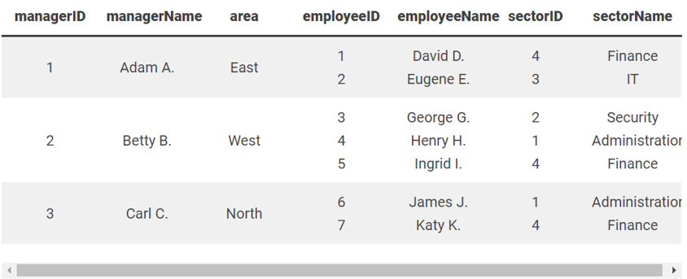
Database Normalization
Example Unnormalized Database
An unnormalized table has multiple values within a single field, as well as redundant information in the worst case.

Slide 6
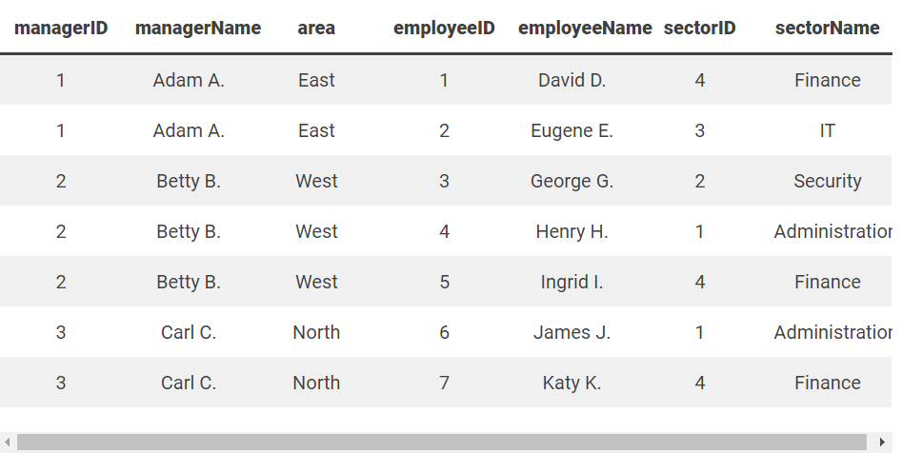
Database Normalization
Step 1: First Normal Form 1NF
To rework the database table into the 1NF, values within a single field must be atomic. All complex entities in the table divide into new rows or columns.
The information in the columns managerID, managerName, and area repeat for each employee to ensure no loss of information.

Slide 7
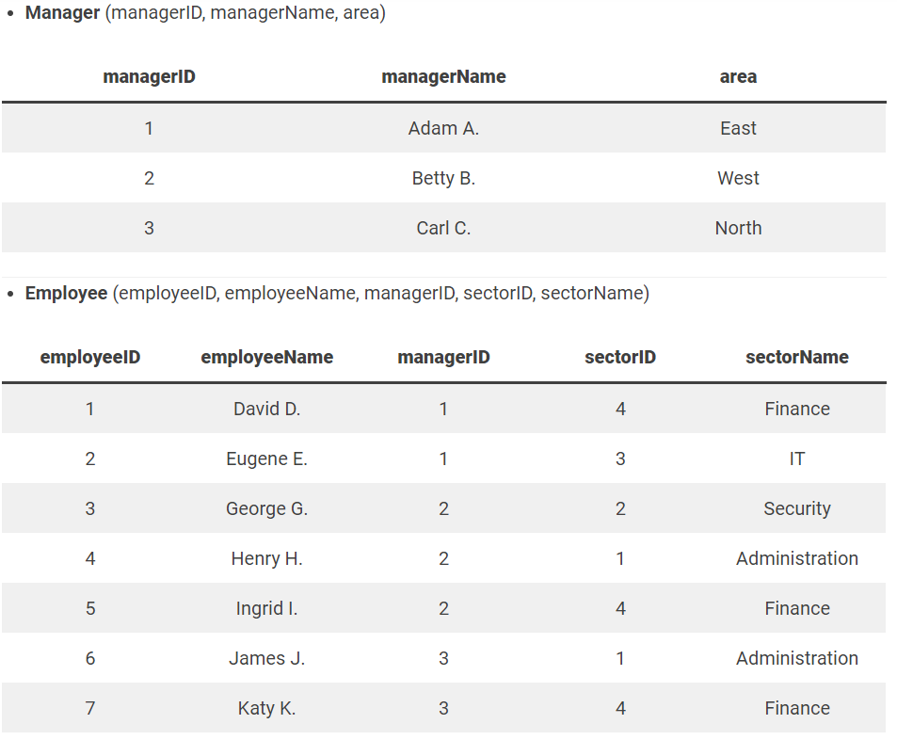
Database Normalization
Step 2: Second Normal Form 2NF
The second normal form in database normalization states that each row in the database table must depend on the primary key.
The table splits into two tables to satisfy the normal form:

Slide 8
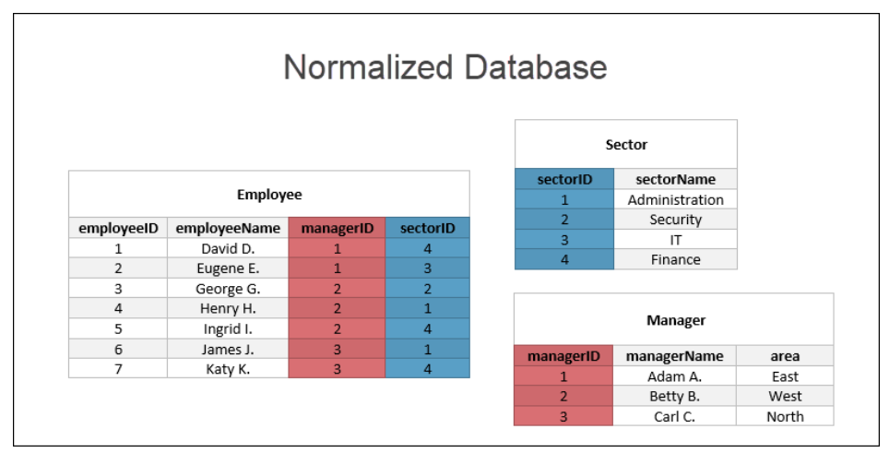
Database Normalization
Step 3: Third Normal Form 3NF
The third normal form decomposes any transitive functional dependencies. Currently, the table Employee has a transitive dependency which decomposes into two new tables:
At this point, the database is normalized. Any further normalization steps depend on the use case of the data.

Slide 9
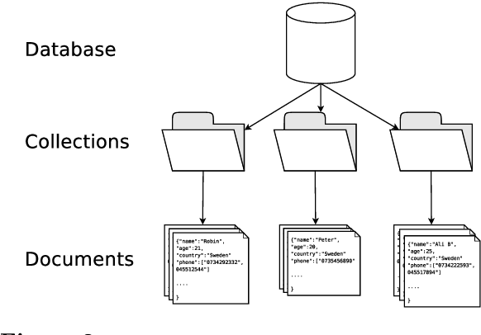
No SQL Database
What is NoSQL?
NoSQL Database is a non-relational Data Management System, that does not require a fixed schema. It avoids joins, and is easy to scale. The major purpose of using a NoSQL database is for distributed data stores
RDBMS Concept
NoSQL Concept

Slide 10
No SQL
Document
{
SID : 100
Name : Abul Kalam,
Phone : 01714---989,
Address : Kalabagan, Dhaka,
Designation : Manager,
Books : [
{id : 2, name : ABC}
{id : 3, name : XYZ}
]
}
Document
{
SID : 101
Name : Akas Ali,
Phone : 01714---456,
Address : Gulshan, Dhaka,
Designation : Executive,
}
SQL
Student
Designation
Book
SID | Name | Phone | Address | DesigID
100 | Abul Kalam | 01714---989 | Kalabagan, Dhaka | 1
101 | Akas Ali | 01714---456 | Gulshan, Dhaka | 2
DesigID | Designation
1 | Manager
2 | Executive
BID | SID | Name
2 | 100 | ABC
3 | 100 | XYZ

Slide 11
[
Collection
]
Document
{
SID : 100
Name : Abul Kalam,
Phone : 01714---989,
Address : Kalabagan, Dhaka,
Designation : Manager,
Books : [
{id : 2, name : ABC}
{id : 3, name : XYZ}
]
}
Document
{
SID : 101
Name : Akas Ali,
Phone : 01714---456,
Address : Gulshan, Dhaka,
Designation : Executive,
}
Document
{
SID : 102
Name : Jamal Ali,
Phone : 01714---456,
Address : Gulshan, Dhaka,
Designation : Executive,
Books : [
{id : 2, name : ABC}
{id : 3, name : XYZ}
]
}
Document
{
SID : 103
Name : Kamal Ali,
Phone : 01714---456,
Address : Gulshan, Dhaka,
Designation : Executive,
}

Slide 12
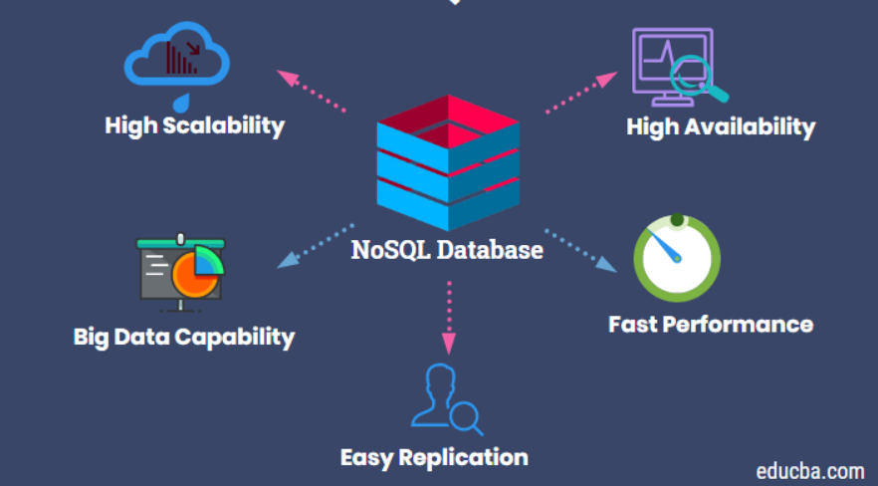
Why No SQL Database

Slide 13

No SQL Database
Amazon, Google, Netflix and Facebook Switched to NoSQL

Slide 14












No SQL Database
RDBMS Database
NoSQL Database

Slide 15
Query Practice
Customers
customer_id | first_name | last_name | phone | email | street | city | state | zip_code
1 | Debra | Burks | NULL | debra.burks@yahoo.com | 9273 Thorne Ave. | Orchard Park | NY | 14127
2 | Kasha | Todd | NULL | kasha.todd@yahoo.com | 910 Vine Street | Campbell | CA | 95008
3 | Tameka | Fisher | NULL | tameka.fisher@aol.com | 769C Honey Creek St. | Redondo Beach | CA | 90278
4 | Daryl | Spence | NULL | daryl.spence@aol.com | 988 Pearl Lane | Uniondale | NY | 11553
5 | Charolette | Rice | (916) 381-6003 | charolette.rice@msn.com | 107 River Dr. | Sacramento | CA | 95820
6 | Lyndsey | Bean | NULL | lyndsey.bean@hotmail.com | 769 West Road | Fairport | NY | 14450
7 | Latasha | Hays | (716) 986-3359 | latasha.hays@hotmail.com | 7014 Manor Station Rd. | Buffalo | NY | 14215
8 | Jacquline | Duncan | NULL | jacquline.duncan@yahoo.com | 15 Brown St. | Jackson Heights | NY | 11372
9 | Genoveva | Baldwin | NULL | genoveva.baldwin@msn.com | 8550 Spruce Drive | Port Washington | NY | 11050
10 | Pamelia | Newman | NULL | pamelia.newman@gmail.com | 476 Chestnut Ave. | Monroe | NY | 10950
11 | Deshawn | Mendoza | NULL | deshawn.mendoza@yahoo.com | 8790 Cobblestone Street | Monsey | NY | 10952
12 | Robby | Sykes | (516) 583-7761 | robby.sykes@hotmail.com | 486 Rock Maple Street | Hempstead | NY | 11550
13 | Lashawn | Ortiz | NULL | lashawn.ortiz@msn.com | 27 Washington Rd. | Longview | TX | 75604
14 | Garry | Espinoza | NULL | garry.espinoza@hotmail.com | 7858 Rockaway Court | Forney | TX | 75126
15 | Linnie | Branch | NULL | linnie.branch@gmail.com | 314 South Columbia Ave. | Plattsburgh | NY | 12901
16 | Emmitt | Sanchez | (212) 945-8823 | emmitt.sanchez@hotmail.com | 461 Squaw Creek Road | New York | NY | 10002

Slide 16
Select Statement
Select specific columns
select first_name, Phone, email, city from customers
Select all columns
select * from customers

Slide 17
Order By
Ascending
select * from customers order by first_name
select * from customers order by first_name asc
Descending
select * from customers order by first_name desc

Slide 18
Filtering with where clause
select first_name, Phone, email, city from customers
where city ='Monsey'
Joining multiple conditions
select first_name, Phone, email, city from customers
where city ='Monsey' and State = 'NY'

Slide 19
Distinct
select distinct last_name from customers
TOP N
select top 1 * from customers order by first_name desc
Like
select * from customers where first_name like 'j%'

Slide 20
Group by
select state, max(zip_code)
from customers
group by state

Slide 21
Practice
https://www.programiz.com/sql/online-compiler/
https://sqliteonline.com/
SQL Tutorial (w3schools.com)
https://www.stratascratch.com/

